Slide 1
Ritz Carlton Hotel Riyadh-Saudi Arabia Irrigation water saving For Landscape Area

Slide 2
Existing Sprayer Sprinkler
Irrigation water on walk ways and Asphalt road

Slide 3
Existing Sprayer Sprinkler
Different type and model in irrigation system all with the same run time.
Water run time is not accurate with the different season and weather changes.

Slide 4
Existing Sprayer Sprinkler
Dry areas , and many of Brown spots on Grass.

Slide 5
Existing Sprayer Sprinkler
Wet areas.

Slide 6
Replace using MP Rotator
Nov, 2015
Replacing the existing sprayer and gear rotors using the Matched precipitation Rotator to covers radius from 2.5 mtr. to 9 mtr.
applied to 3 Solenoid Valves.

Slide 7
Existing different Nozzles
More than 150 Sprayers and 4 Rotors.
9 different types of Spry nozzles and rotors on small area.
Difficult in operation and future maintenance.

Slide 8
Replaced MP Rotator Nozzles
MP Rotator Qty
MP 1000 90 ͦ-210 30
MP 2000 90 ͦ-210 ͦ 35
MP 3000 90 ͦ-210 ͦ 05
MP 3000 360 ͦ 03
MP 800 90 ͦ-210 ͦ 03
PR: 12 mm /hr

Slide 10
Irrigation Software to manage and monitor your system

Slide 11
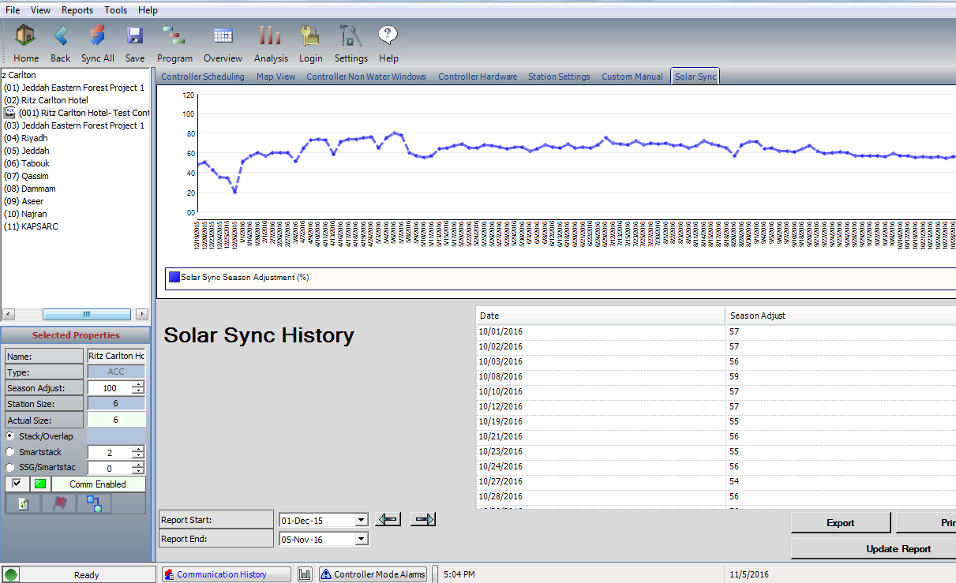
Using Solar Sync to Adjust The irrigation Run Time as per the weather condition.

Slide 12
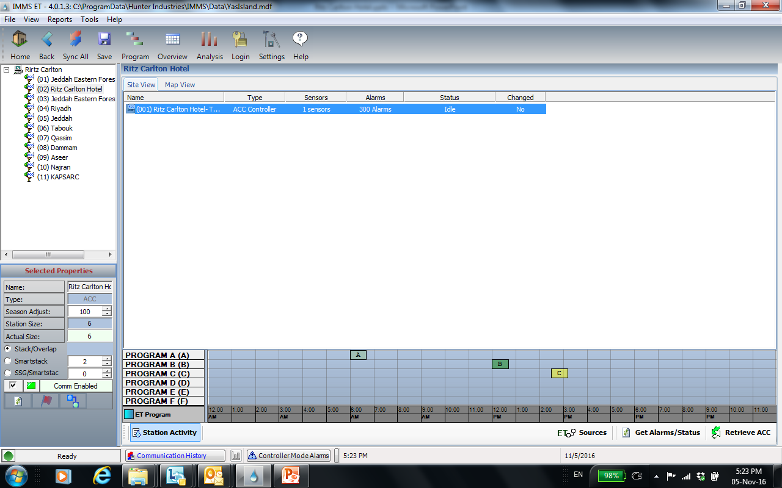
Station Activity

Slide 13
Increased the valves run time as per Landscape Manager

Slide 15
MP Rotator in Operation
Sep 01 , 2016

Slide 16
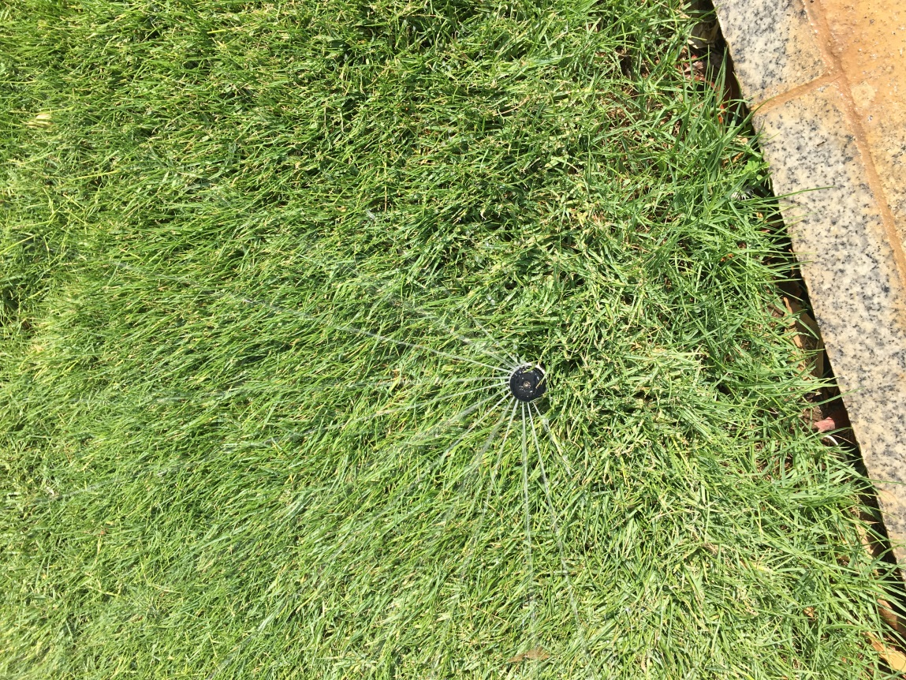
MP Rotator in Operation
Sep 01 , 2016
Healthy Grass ,
Dray curbstone and walk ways

